Slide 1
Cost Calculations
21.10.2021 Design project in chemical engineering, part B CHEM-E1780
Oliwer Sliczniuk

Slide 2
Direct and Indirect costs
Direct costs:
purchased equipment
purchased equipment installation
instrumentation and controls
piping
electrical system
buildings including services,
service facilities
land and
yard improvements.
Indirect costs:
engineering and supervision,
legal expenses,
construction expenses,
contractor’s fees, and
contingency.

Slide 3
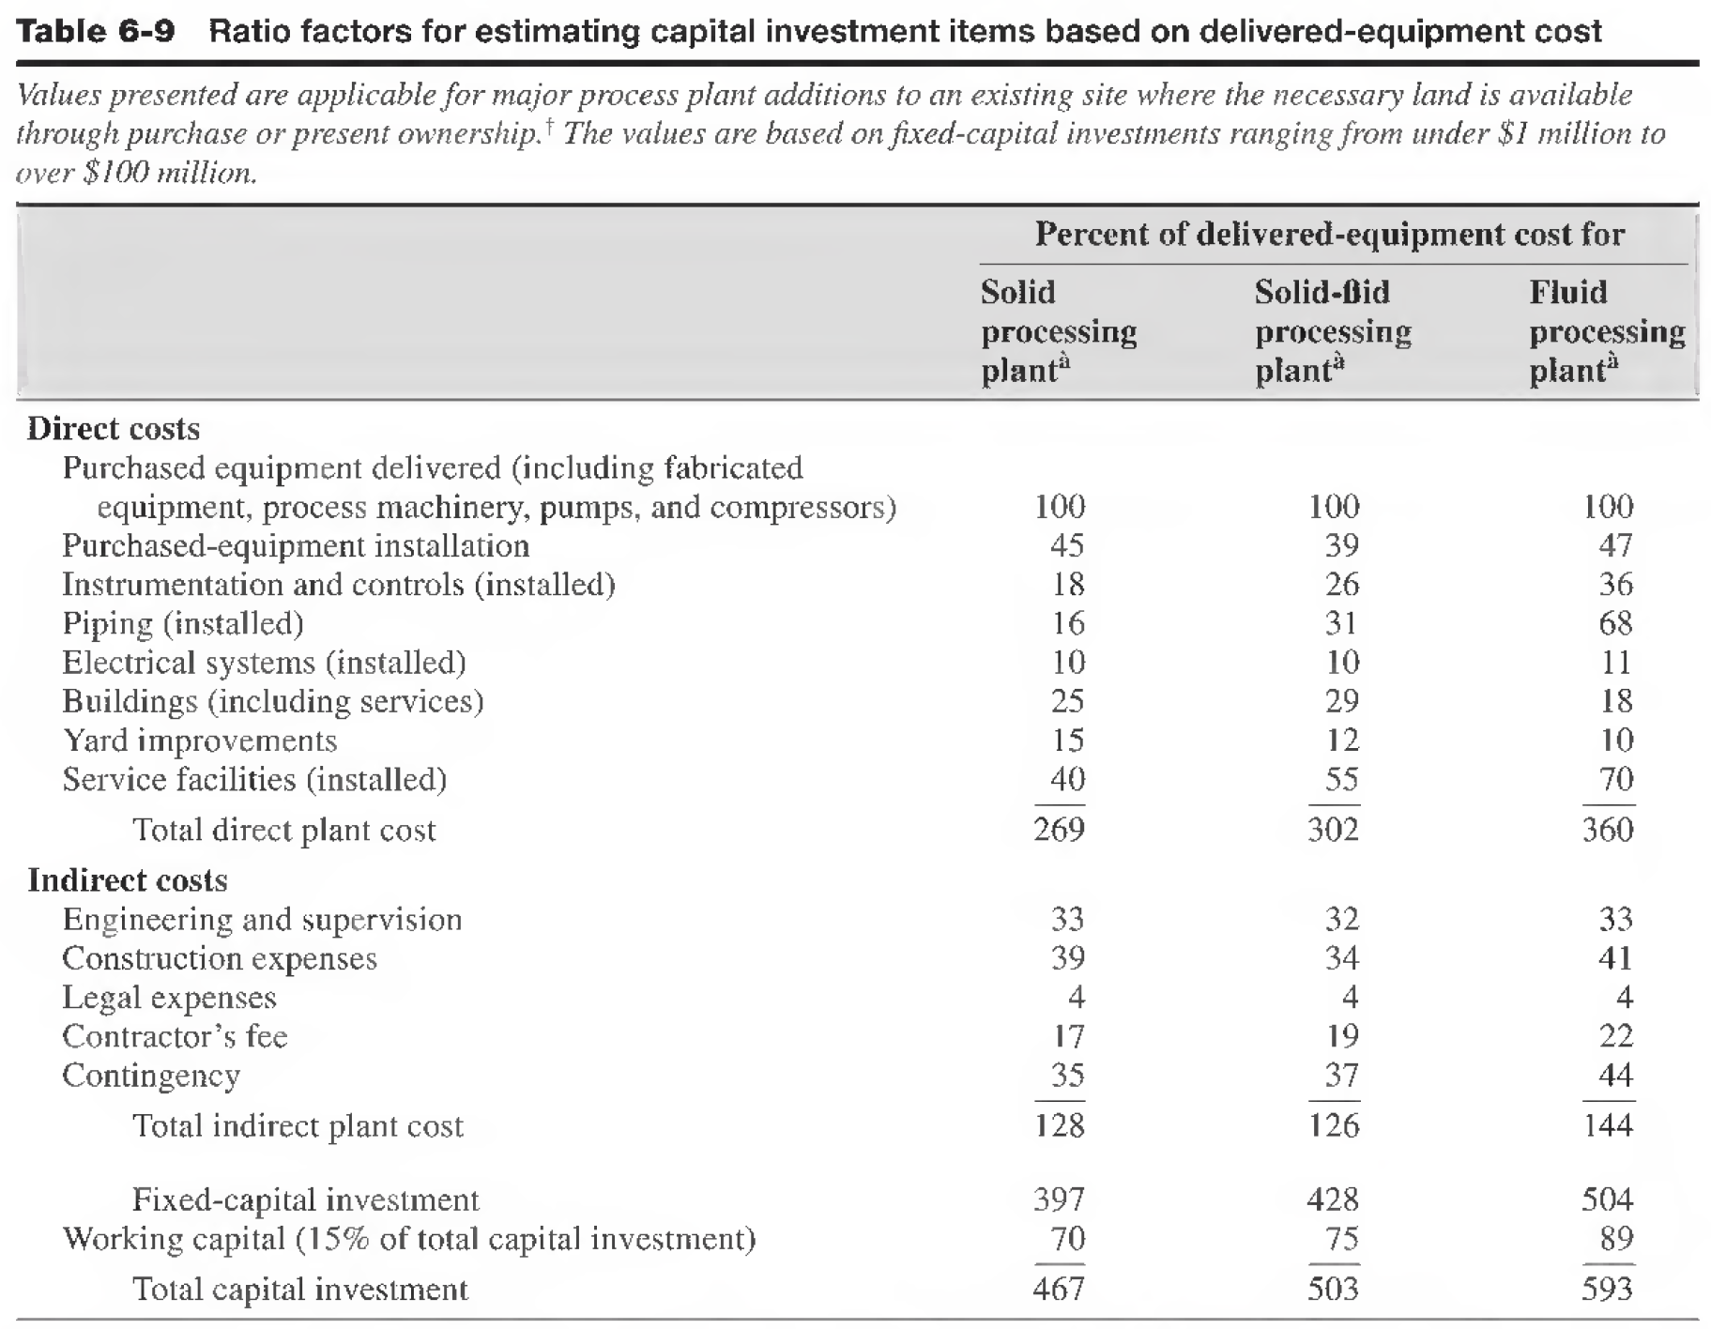

Direct and Indirect costs
Calculation of direct and indirect costs based on delivered equipment cost
Delivered equipment cost =
1.1 * purchased equipment cost
(Delivery accounts for 10 % of purchased equipment cost)
Note:
OSBL = 20 to 50 % of ISBL
*40 % is ideally chosen
If you calculate Contingency as a fraction of DEC, check if it gives a value that is 15 to 20 % of FCI, if not take
Contingency = 15 – 20 % of FCI
Fixed capital investment
FCI = ISBL + OSBL + indirect costs + contingency
Working capital (WC) = 10 – 15 % of FCI
Guide: 3 months work
Total Investment = FCI + WC
ISBL
OSBL

Slide 4
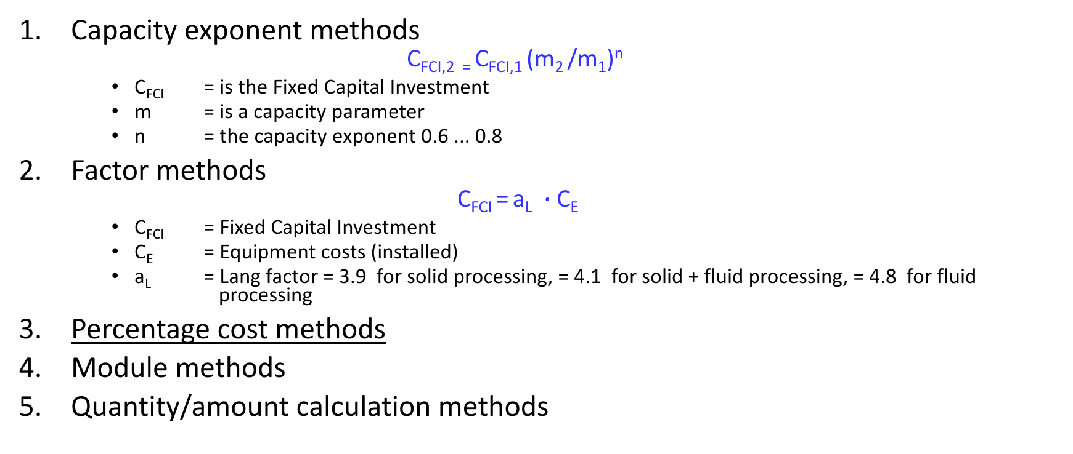
CAPITAL COST ESTIMATION METHODS
Capacity exponent methods
$$\text{C}\text{FCI}\text{,2 = }\text{C}\text{FCI}\text{,1 }\text{(}\text{m}\text{2 }\text{/}\text{m}\text{1}\text{)}\text{n}$$
C_{FCI} = is the Fixed Capital Investment
m = is a capacity parameter
n = the capacity exponent 0.6 ... 0.8
Factor methods
$$\text{C}\text{FCI} \text{=} \text{a}\text{L} ∙\text{C}\text{E}$$
C_{FCI} = Fixed Capital Investment
C_{E} = Equipment costs (installed)
a_{L} = Lang factor = 3.9 for solid processing, = 4.1 for solid + fluid processing, = 4.8 for fluid processing
Percentage cost methods
Module methods
Quantity/amount calculation methods

Slide 5
Percentage Method
Percentage method is most commonly used for capital cost estimation. Based on total delivered equipment cost and other cost items are added as percentage.
Cost for equipment: historical data: adjustments needed for capacity, material, p, T, inflation or from vendor (FOB-price). Aspen economic analyzer can be used.
Other plant items as %
installation, piping, instruments, constructions, design etc.
Contingency is the amount of money to cover the uncertainties of design, permits, purchasing and construction
Outside battery limit (OSBL) cost separately

Slide 6
CAPEX – capital expenditure example
# | Cost item | % eq. | M€ | % of C_{FCI} | % of total
1 | Equipment (purchased) | 100 | 58,0 | 29,6 | 27,1
2 | Steel structure & support | 10 | 5,7 | 2,9 | 2,7
3 | Insulation & painting | 12 | 7,2 | 3,7 | 3,4
4 | Piping (inst.) | 26 | 15,2 | 7,8 | 7,1
5 | Instrumentation & controls (inst.) | 20 | 11,4 | 5,8 | 5,3
6 | Electricity (inst.) | 16 | 9,5 | 4,8 | 4,4
7 | Buildings (incl. services) | 13 | 7,6 | 3,9 | 3,6
8 | OSBL | 30 | 17,4 | 8,9 | 8,1
9 | Land | 10 | 6,1 | 3,1 | 2,8
10 | Engineering design & supervision | 20 | 11,6 | 5,9 | 5,4
11 | Construction & start-up | 20 | 11,6 | 5,9 | 5,4
 | Subtotal (1-11) |  | 161,3 | 82,3 | 75,4
12 | Contractor fee | 9,8 | 5,7 | 2,9 | 2,7
13 | Contingency | 40,0 | 23,2 | 11,8 | 10,8
14 | Raw material investment |  | 5,9 | 3,0 | 2,7
 | Fixed capital C_{FCI} |  | 196 M€ |  | 16,2
 | Working capital |  | 18 M€ |  | 8,4
 |  |  | 214 M€ | 100,0 | 100,0

Slide 7
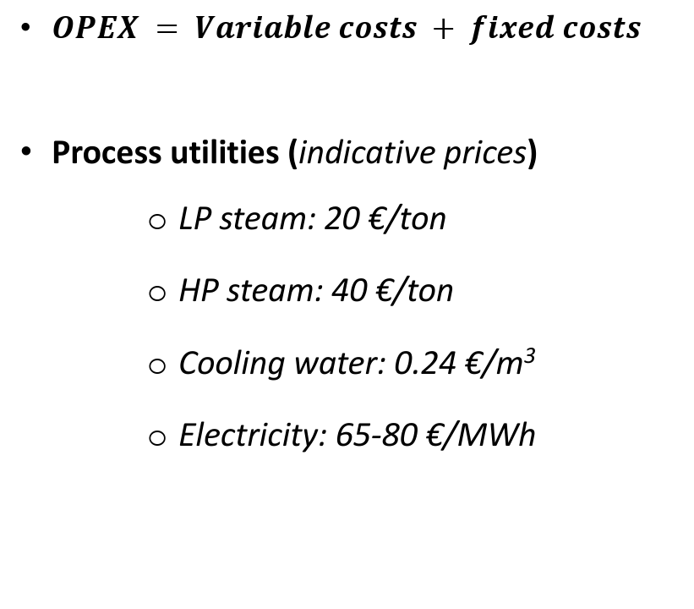
OPEX – Operating costs
$OPEX = Variable costs + fixed costs$
Process utilities (indicative prices)
LP steam: 20 €/ton
HP steam: 40 €/ton
Cooling water: 0.24 €/m³
Electricity: 65-80 €/MWh
Variable operating cost
Raw materials | Calculated
Utilities | Calculated
Steam | Calculated
Electricity | Calculated
Water | Calculated
Other utilities | Calculated
Catalysts & solvents | Calculated
Operating supplies | 0.5 % - 1 % of FCI
Wastes disposal | 0.5 %- 10 % of FCI
Fixed operating cost
Operating labor with overheads (OL) | Calculated
Supervision | 20-30 % of OL
Employee benefits | 20-25 % of OL
Laboratory charges | 10-20 % of OL
Maintenance (includes materials and labor) | 3 % - 6 % of FCI
Insurance and taxes | 1-3 % of FCI
Rent of land (and or buildings) | 1-2 % of (ISBL + OSBL cost)

Slide 8
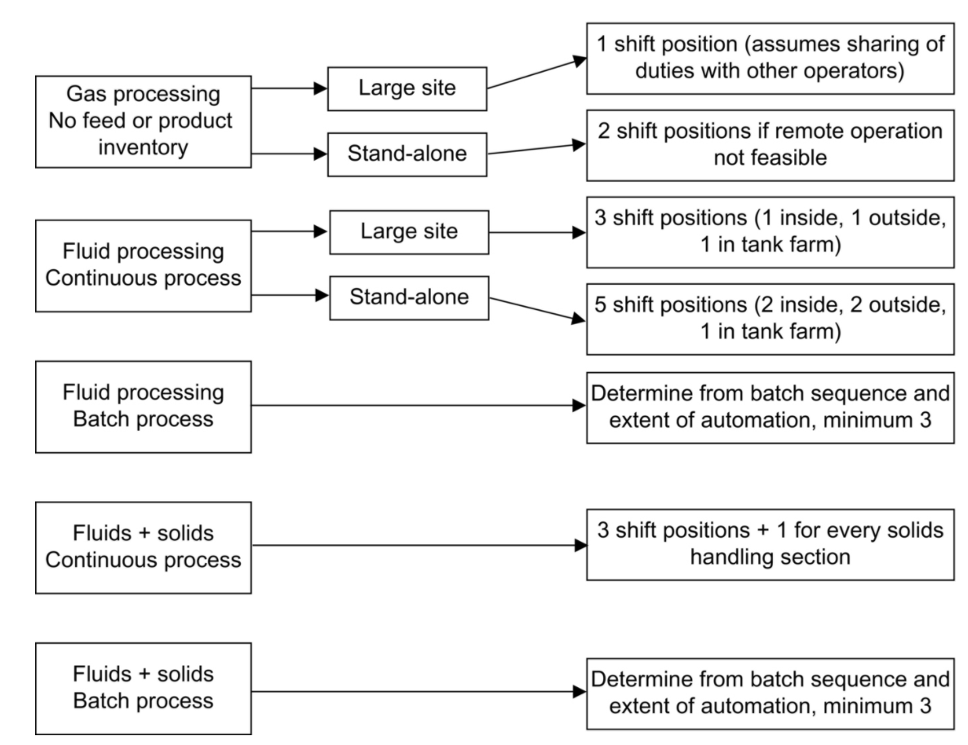
Operating labor calculation
No. of shifts is normally 5
Almost all plants are operated on a shift-work basis (even batch plants), with typically 4.8 operators per shift position.
Salaries with overheads
For 1 operator: 60000 - 75000 €/yr.
For 1 manager: 100000 - 150000 €/yr.
Also consider employees needed for administration, R & D (lab), marketing and distribution and quality control.
For employees, the salary of employee with overheads can be taken as 60000-75000 €/yr.
Algorithm for determing the number of shifts

Slide 9
Operating labor

Slide 10
OPEX - Operational cost example
1 | Raw materials | Unit | Usage | €/unit | k€/a | %
 | Na₂CO₃ | t/h | 1,24 | 150 | 1486 | 10,5
 | H₂SO₄ | t/h | 0,119 | 50 | 48 | 0,3
 | EtOH | t/h | 1,86 | 450 | 6711 | 47,5
2 | Utilities
 | Water | t/h | 11,1 | 1 | 89 | 0,6
 | N₂ | t/h | 0,08 | 200 | 130 | 0,9
 | Steam | t/h | 0,075 | 25 | 15 | 0,1
 | Electricity | MWh | 6912 | 60 | 480 | 3,4
3 | Others
 | Waste | t/h | 3,6 | 5 | 144 | 1,0
 | Instrument air |  |  |  | 10 | 0,1
 | Maintenance and repairs |  |  |  | 2000 | 14,2
A | Variable operating cost |  |  |  | 11112
 | Salaries | €/a | 18 | 65000 | 1170 | 8,3
 | Insurance | €/a |  |  | 800 | 5,7
 | Administration | €/a |  |  | 150 | 1,1
 | R&D | €/a |  |  | 300 | 2,1
 | Rents | €/a |  |  |  | 0,0
 | Quality control | €/a |  |  | 300 | 2,1
 | Security | €/a |  |  | 300 | 2,1
B | Fixed operating cost |  |  |  | 3020
C | Total operating cost |  |  |  | 14132 | 100

Slide 11
Estimation of Fixed Capital Investment (CFCI)
 | Items | %
1 | Equipment (delivered) | 100
2 | Steel structure & support | 18-20
3 | Insulation equip. installed. 40-45% E | 10-15
4 | Painting | 5-10
5 | Piping (installed) | 16-70
6 | Instrumentation & controls (inst.) | 10-50
7 | Electricity (installed) | 15-30
8 | Buildings (incl. services) | 15-45
9 | Land | 0-10
10 | Yard (site development) | 10-20
11 | Engineering design and supervision | 30-40
12 | Construction and start-up | 35-60
13 | Total (1-12)
14 | OSBL - Service facilities (utilities, administration, offsites: storages, nonproc. equipment, fire protection, distribution and packaging, waste disposal etc..), 50-80% of total (1-12)
15 | Contractor fees, (2-6% of FCI) | 10-45
16 | Contingency, (15-25% of FCI) | 50-80

Slide 12
Profitability
Profitability is the economic performance indicator. Requires annual income and expenditure, as well as investment. The two latter depend on the process technology, so their evaluation is largely a technical matter.
Incomes
SALES
Net income
Operating costs
Profitability
TECHNOLOGY
Capital cost

Slide 13
Measures of profitability
Methods which are not considered the time value of money
Payback time, (time units)
Return on investment (ROI-%)
Discount Methods
Net Present Value (NPV)
Internal Rate of Return (IRR-%)
Annuity

Slide 14
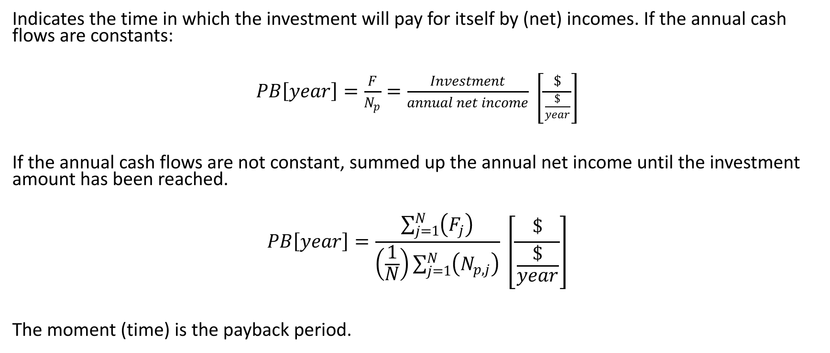
Payback time (PB)
Indicates the time in which the investment will pay for itself by (net) incomes. If the annual cash flows are constants:
$PB\left[year\right]=\frac{F}{N_{p}}=\frac{Investment}{annual net income} \left[\frac{\$}{\frac{\$}{year}}\right]$
If the annual cash flows are not constant, summed up the annual net income until the investment amount has been reached.
$$PB\left[year\right]=\frac{\sum_{j=1}^{N}{\left(F_{j}\right)}}{\left(\frac{1}{N}\right)\sum_{j=1}^{N}{\left(N_{p,j}\right)}} \left[\frac{\$}{\frac{\$}{year}}\right]$$
The moment (time) is the payback period.

Slide 15
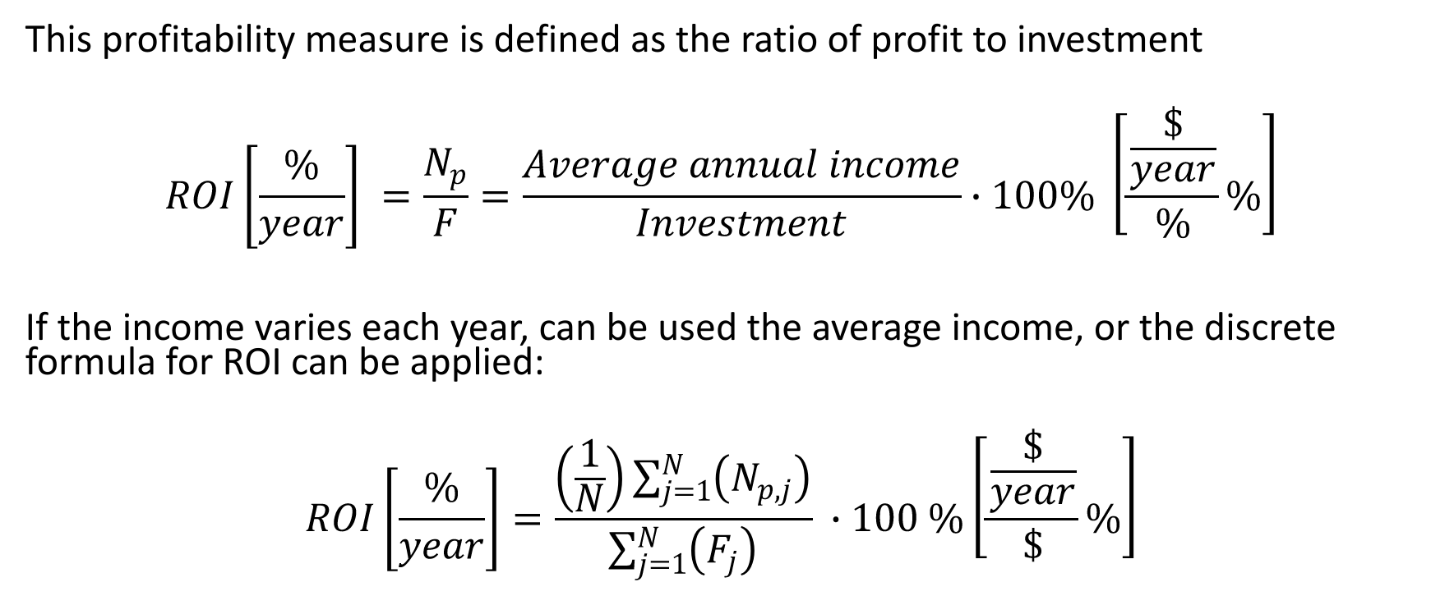
Return on Original Investment (ROI)
This profitability measure is defined as the ratio of profit to investment
$$ROI\left[\frac{\%}{year}\right] =\frac{N_{p}}{F}=\frac{Average annual income}{Investment}∙100\% \left[\frac{\frac{\$}{year}}{\%}\%\right]$$
If the income varies each year, can be used the average income, or the discrete formula for ROI can be applied:
$$ROI\left[\frac{\%}{year}\right]=\frac{\left(\frac{1}{N}\right)\sum_{j=1}^{N}{\left(N_{p,j}\right)}}{\sum_{j=1}^{N}{\left(F_{j}\right)}} ∙100 \%\left[\frac{\frac{\$}{year}}{\$}\%\right]$$

Slide 16
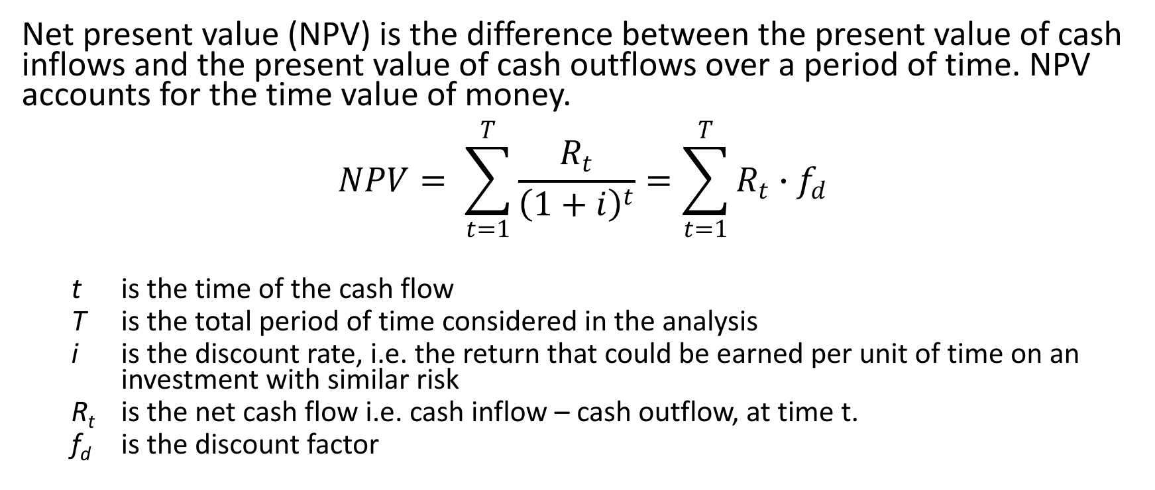
Net Present Value (NPV)
Net present value (NPV) is the difference between the present value of cash inflows and the present value of cash outflows over a period of time. NPV accounts for the time value of money. $$NPV= \sum_{t=1}^{T}{\frac{R_{t}}{{\left(1+i\right)}^{t}}=\sum_{t=1}^{T}{R_{t}∙f_{d}}}$$
t is the time of the cash flow
T is the total period of time considered in the analysis
i is the discount rate, i.e. the return that could be earned per unit of time on an investment with similar risk
R_{t} is the net cash flow i.e. cash inflow – cash outflow, at time t.
f_{d} is the discount factor
0 1 2 3 4 ….

Slide 17
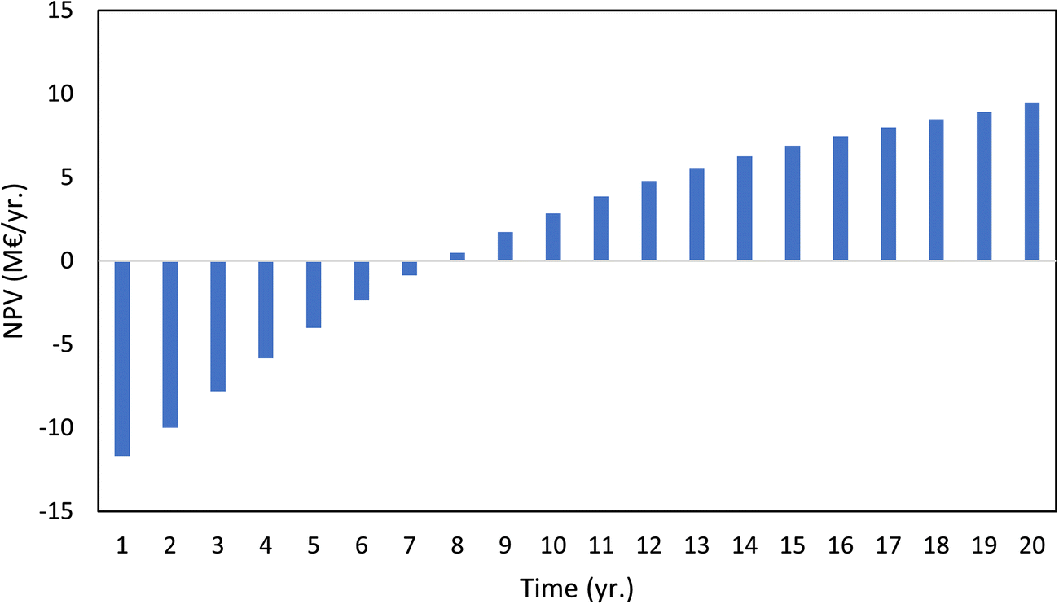
NPV example

Slide 18
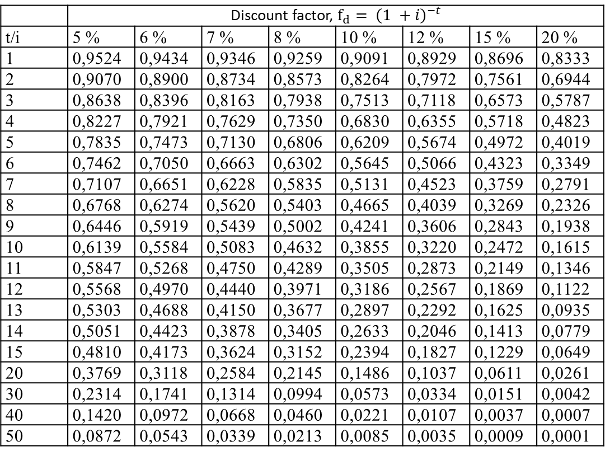
Net Present Value (NPV)
 | Discount factor, $f_{d}= {\left(1 +i\right)}^{−t}$
t/i | 5 % | 6 % | 7 % | 8 % | 10 % | 12 % | 15 % | 20 %
1 | 0,9524 | 0,9434 | 0,9346 | 0,9259 | 0,9091 | 0,8929 | 0,8696 | 0,8333
2 | 0,9070 | 0,8900 | 0,8734 | 0,8573 | 0,8264 | 0,7972 | 0,7561 | 0,6944
3 | 0,8638 | 0,8396 | 0,8163 | 0,7938 | 0,7513 | 0,7118 | 0,6573 | 0,5787
4 | 0,8227 | 0,7921 | 0,7629 | 0,7350 | 0,6830 | 0,6355 | 0,5718 | 0,4823
5 | 0,7835 | 0,7473 | 0,7130 | 0,6806 | 0,6209 | 0,5674 | 0,4972 | 0,4019
6 | 0,7462 | 0,7050 | 0,6663 | 0,6302 | 0,5645 | 0,5066 | 0,4323 | 0,3349
7 | 0,7107 | 0,6651 | 0,6228 | 0,5835 | 0,5131 | 0,4523 | 0,3759 | 0,2791
8 | 0,6768 | 0,6274 | 0,5620 | 0,5403 | 0,4665 | 0,4039 | 0,3269 | 0,2326
9 | 0,6446 | 0,5919 | 0,5439 | 0,5002 | 0,4241 | 0,3606 | 0,2843 | 0,1938
10 | 0,6139 | 0,5584 | 0,5083 | 0,4632 | 0,3855 | 0,3220 | 0,2472 | 0,1615
11 | 0,5847 | 0,5268 | 0,4750 | 0,4289 | 0,3505 | 0,2873 | 0,2149 | 0,1346
12 | 0,5568 | 0,4970 | 0,4440 | 0,3971 | 0,3186 | 0,2567 | 0,1869 | 0,1122
13 | 0,5303 | 0,4688 | 0,4150 | 0,3677 | 0,2897 | 0,2292 | 0,1625 | 0,0935
14 | 0,5051 | 0,4423 | 0,3878 | 0,3405 | 0,2633 | 0,2046 | 0,1413 | 0,0779
15 | 0,4810 | 0,4173 | 0,3624 | 0,3152 | 0,2394 | 0,1827 | 0,1229 | 0,0649
20 | 0,3769 | 0,3118 | 0,2584 | 0,2145 | 0,1486 | 0,1037 | 0,0611 | 0,0261
30 | 0,2314 | 0,1741 | 0,1314 | 0,0994 | 0,0573 | 0,0334 | 0,0151 | 0,0042
40 | 0,1420 | 0,0972 | 0,0668 | 0,0460 | 0,0221 | 0,0107 | 0,0037 | 0,0007
50 | 0,0872 | 0,0543 | 0,0339 | 0,0213 | 0,0085 | 0,0035 | 0,0009 | 0,0001

Slide 19
Net Present Value (NPV)
If... | It means... | Then...
NPV > 0 | the investment would add value to the firm | the project may be accepted
NPV < 0 | the investment would subtract value from the firm | the project may be rejected
NPV = 0 | the investment would neither gain nor lose value for the firm | This project adds no monetary value. Decision should be based on other criteria, e.g., strategic positioning or other factors not explicitly included in the calculation.

Slide 20
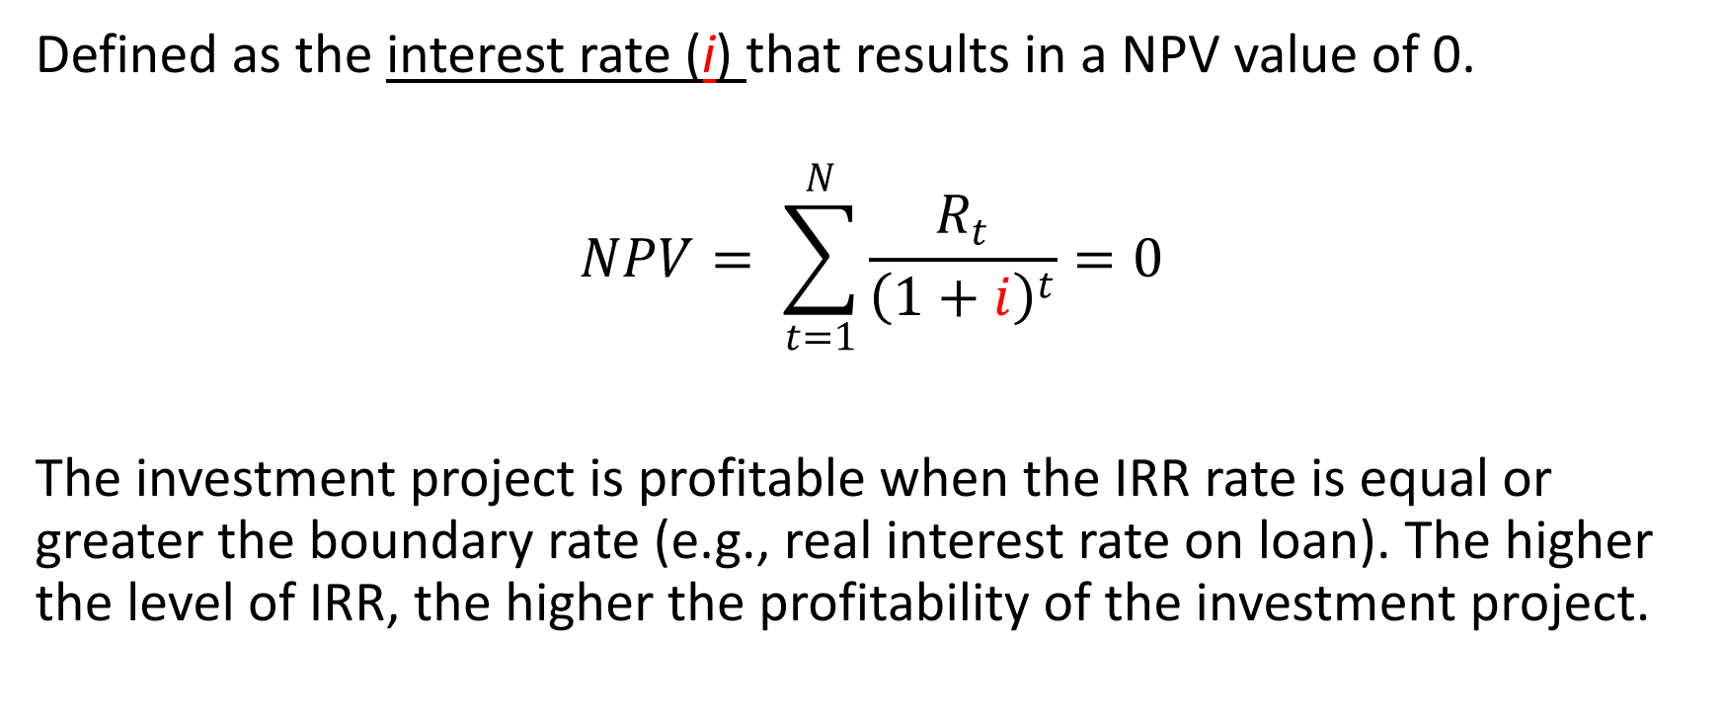
Internal Rate of Return (IRR)
Defined as the interest rate (i) that results in a NPV value of 0.
$$NPV= \sum_{t=1}^{N}{\frac{R_{t}}{{\left(1+i\right)}^{t}}=0}$$
The investment project is profitable when the IRR rate is equal or greater the boundary rate (e.g., real interest rate on loan). The higher the level of IRR, the higher the profitability of the investment project.

Slide 21
Sensitivity analysis
How the profitability changes with different variables.
For which variable profitability is most sensitive.
When to achieve the profitability limit.

Slide 22
Cost estimations
Purchased equipment cost serves as a basis for the estimation of capital costs of a project.
ASPEN uses unique volumetric models to develop estimates rather than taking a capacity factored approach.
Volumetric models of equipment include associated plant data in the equipment costs leading to more accurate cost estimations based on consistent technical and economic information.
Aspen Activated Economics (AEA) and Aspen Process Economic Analyzer (APEA) use data collected from engineering, procurement, and construction (EPC) companies and equipment manufacturers.
The advantage of using the AEA for cost estimation compared to other methods is its integration with simulation software (Aspen Plus and Aspen HYSYS).

